Slide 1
UNSW Business School/ Marketing
MARK 5828 Advertising Analytics
W1 - Picture Ad Analytics
22 Feb 2019
Lecturer: Dr. Junbum Kwon
Contributors: Dr. Osamah Al-Qershi, Kane Walter, James Lin, Daniel Han-Chen

Slide 2
Content
Picture Advertising
Case study: DHC Korea Instagram Picture Ad
How to extract pictorial information
Regression: which X variables affect Y?
Data coding & interpretation for categorical variable
P-value for testing the significance of effect
Analysis: Outliers, control X variables
Conclusion
Notes:
DHC – cosmestics company

Slide 3


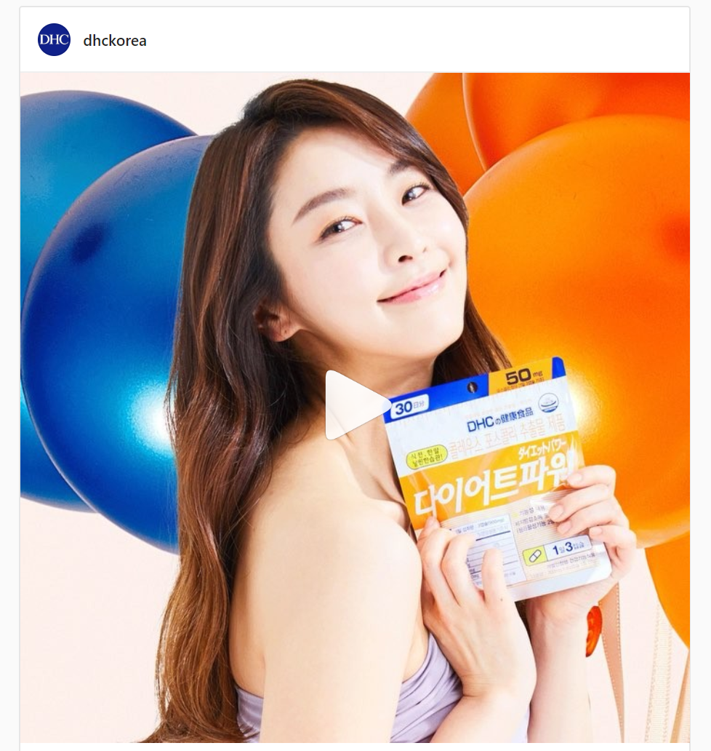

1. Picture Advertising
website

Slide 4

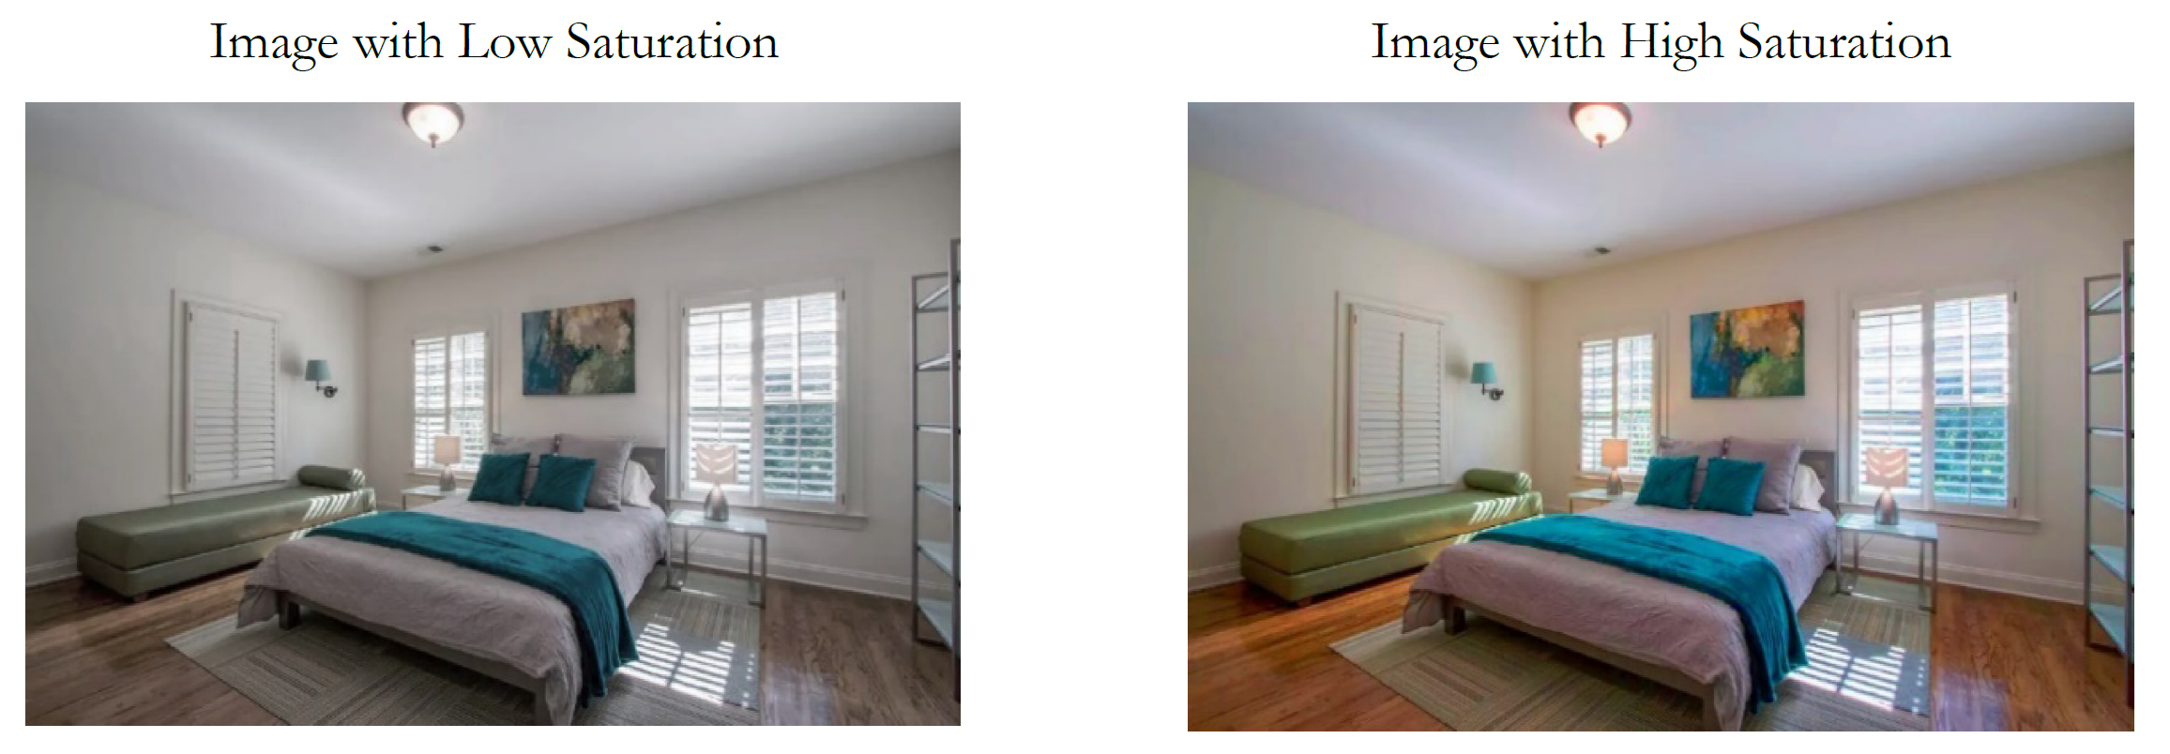
Picture Ad in Airbnb
The same room but different picture makes big difference in demand
How Much Is an Image Worth? Airbnb Property Demand Estimation Leveraging Large Scale Image Analytics, 2018, Zhang, Lee, Singh, Srinivasan

Slide 5
2. Case study:
DHC Korea Instagram Picture Ad

Slide 6

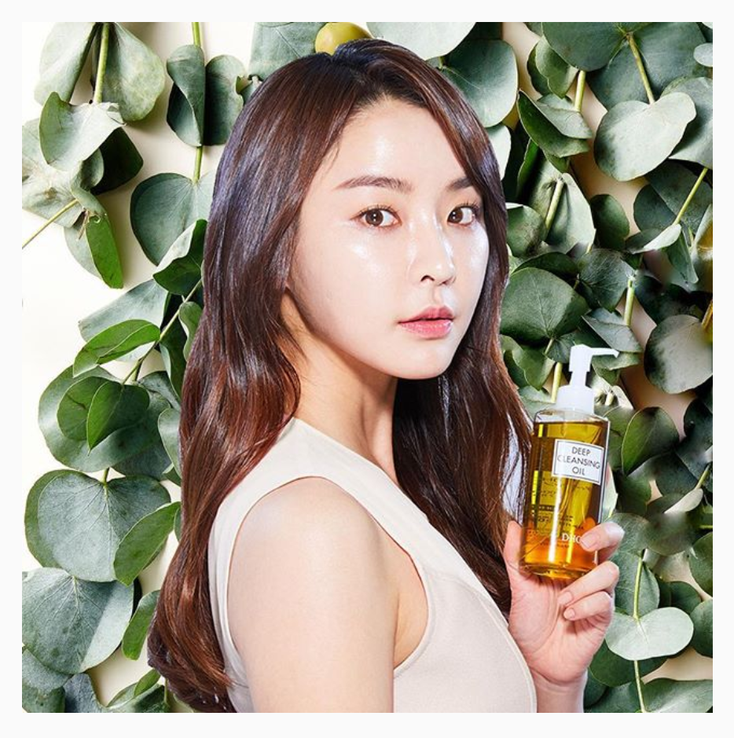
Case study: DHC Korea Instagram Picture Ad
Model: Nana

Slide 7
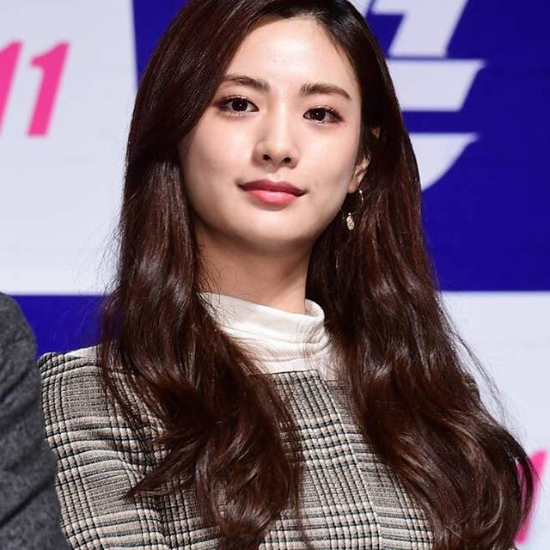
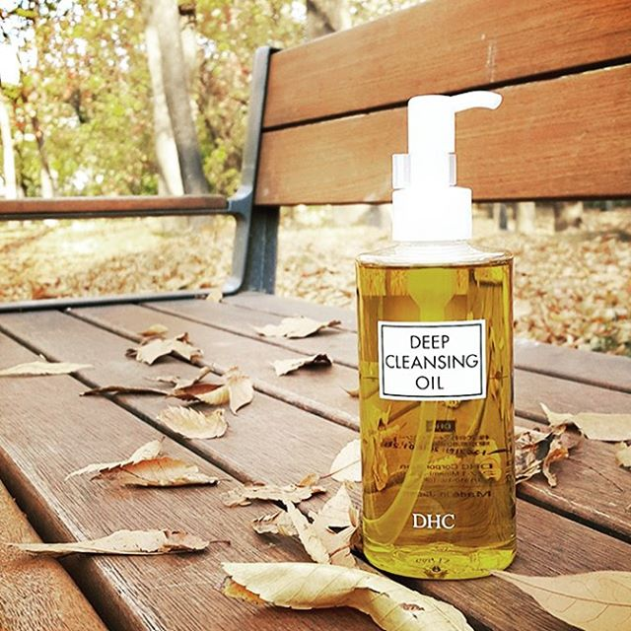
DHC Korea wants to know the best ad strategy
Goal 1:
(1) Model
(2) Product
(3) Model + Product

Slide 8
Goal 2: helpful pictorial information?
Colourful
Particular colour: Green, Black,…
Contrast
Clarity
Brightness
….

Slide 9
Pictorial Information Extraction
Microsoft / Google API (Application Programming Interface)
Python library for image characteristics: color, brightness, balance, clarity, contrast
Picture mapping: (e.g. Google photo search)

Slide 10
Pictorial Information Extraction
Microsoft / Google API (Application Programming Interface)
Python library for image characteristics: color, brightness, balance, clarity, contrast
Picture mapping: (e.g. Google photo search)
Notes:
Apply ai to identify pictorial information

Slide 11
Microsoft Computer Vision API
https://azure.microsoft.com/en-us/services/cognitive-services/computer-vision/
- Object / text detection
- Recognise celebrities and landmarks
For the Instagram case study, we found
- Celebrity
- Dominant Colour
Notes:
Using deep learning and from millions of data/models
Tags or description to make it easy
Eg dominant color
Detect from text
Handwriting
Recognise celebrities or someone famous
Age, gender similar to html

Slide 12
Microsoft Face API
https://azure.microsoft.com/en-au/services/cognitive-services/face/
Face verification
Face detection
Emotion recognition
Notes:
Focus on the face similar to FB detection
Its like html the way they have specific labels

Slide 13
Google Computer Vision API
https://cloud.google.com/vision/
Object detection
Face / Celebrity detection
Logo detection
Landmark detection
Product Search
Image attributes
Notes:
- Google catching up with Microsoft on this which is super cool

Slide 14
Pictorial Information Extraction
Microsoft / Google API (Application Programming Interface)
Python library for image characteristics: color, brightness, balance, clarity, contrast
Picture mapping: (e.g. Google photo search)

Slide 15
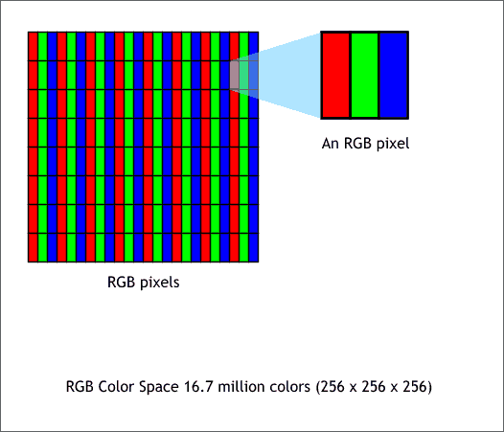
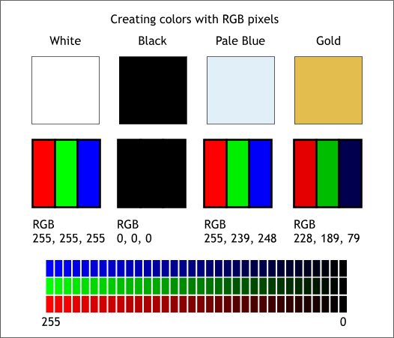
Images and pixels In digital imaging, a pixel is a physical point in a an image, or the smallest controllable element of a picture represented on the screen.

Slide 16
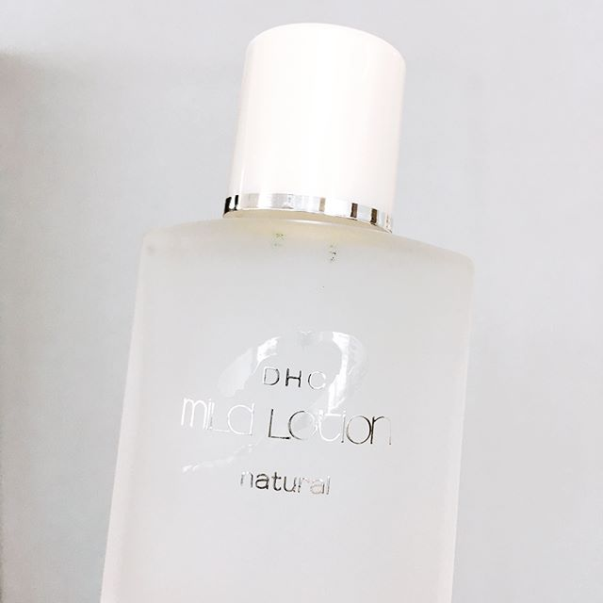


Image characteristics - Colour saturation
= the intensity (purity) of colour in an image. As the saturation increases, the colours appear to be more pure (true). As the saturation decreases, the colours appear to be more washed-out or pale.
e.g. Primary colors red, blue and yellow are considered truest version color as they are fully saturated.
Saturation = 4.26 (low) Likes = 60 | Saturation = 201.7 (high) Likes = 2056
Low | High
(Original colour)

Slide 17
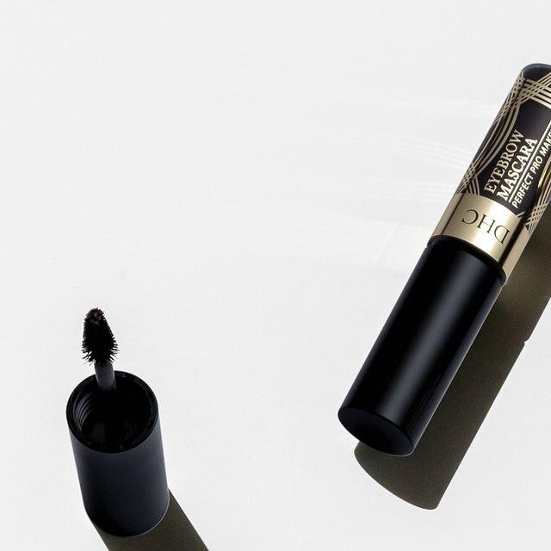
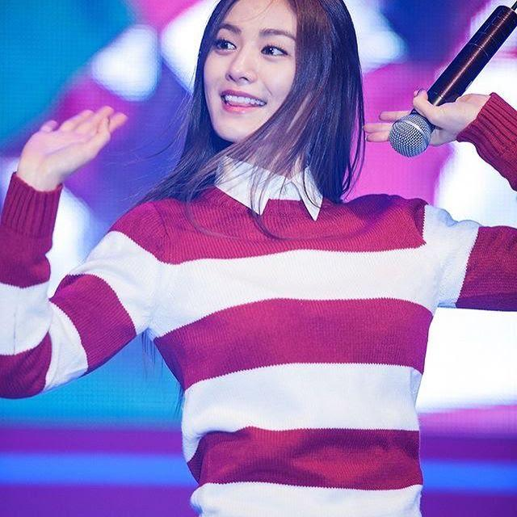
Colourfulness
Measures how colourful the image is.
Colourfulness = 6 (low) Likes = 36 | Colourfulness = 91 (high) Likes = 311

Slide 18
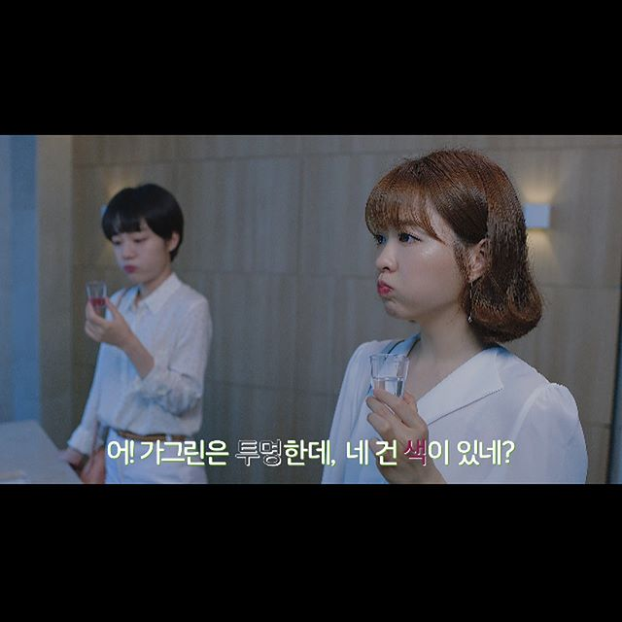
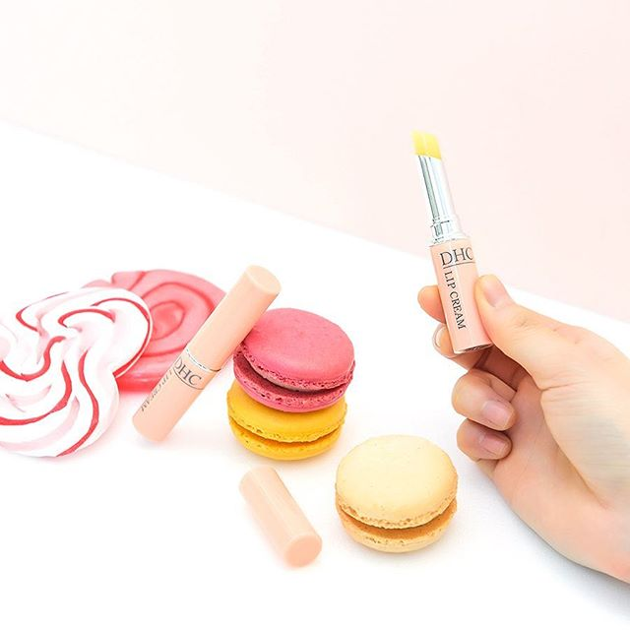
Brightness
The average intensity (illumination) of all pixels on the image. (range : 0 – 255)
brightness = 55.4 (low) Likes = 23 | brightness = 236.3 (high) Likes = 839

Slide 19

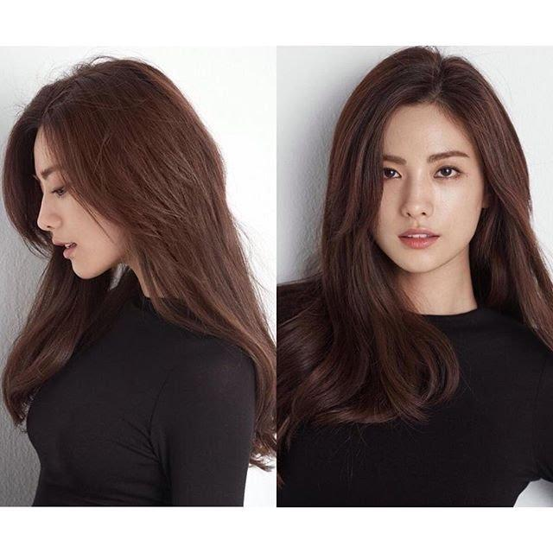
Contrast of Brightness
The standard deviation of pixel intensity over the whole image.
Contrast = 13.81 (low) Likes = 3 | Contrast = 94.5 (high) Likes = 889

Slide 20
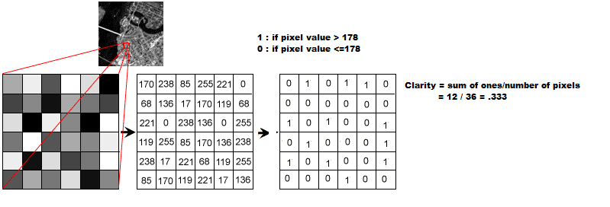


Image clarity
The percentage of the bright pixels in the image. (range: 0 ~ 1 )
Clarity = 0 (low) Likes = 55 | Clarity = .98 (high) Likes = 2090
Clarity = sum of ones / number of pixels
= 12 / 36 = 0.333
178 is a threshold equals to 70% of the maximum intensity value 255

Slide 21
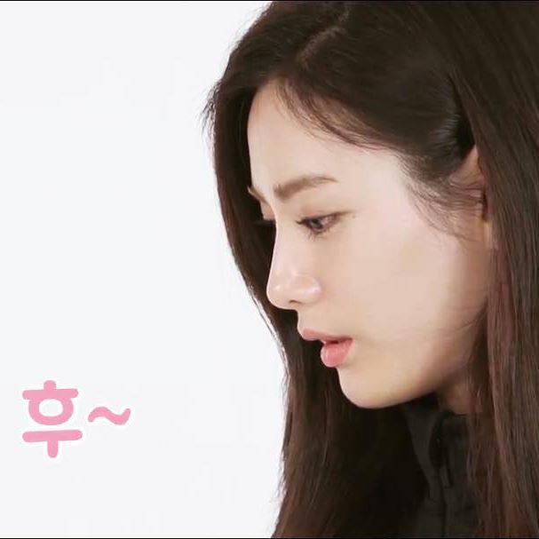
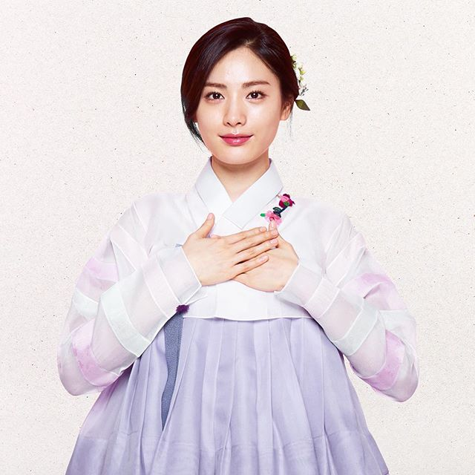
Visual Balance Colour
It compares the left half to the right half of an image based on colours. So, it depends on difference between each pixel and its symmetrical pixel (around vertical axis)
Balance = -267.57 (low) Likes = 82 | Balance = -23.3 (high) Likes = 165
vertical axis

Slide 22
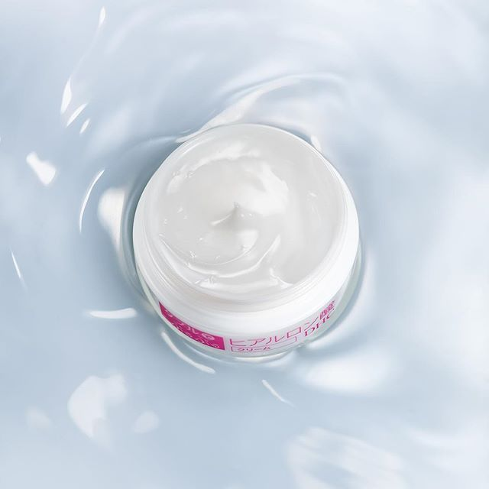
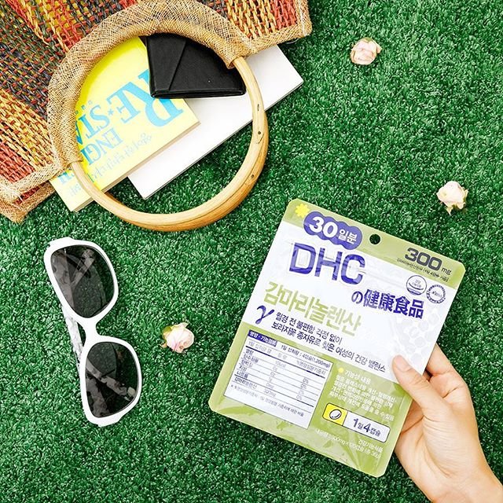
Number of lines
It measures how busy the image is.
lines = 0 (low) Likes = 9 | lines = 21 (high) Likes = 213
Notes:
Interesting how this Is portrayed
Complexity of the image

Slide 23

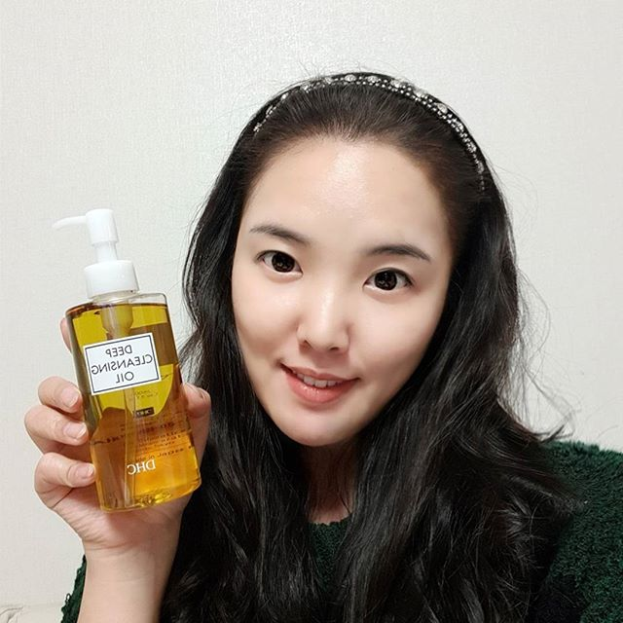
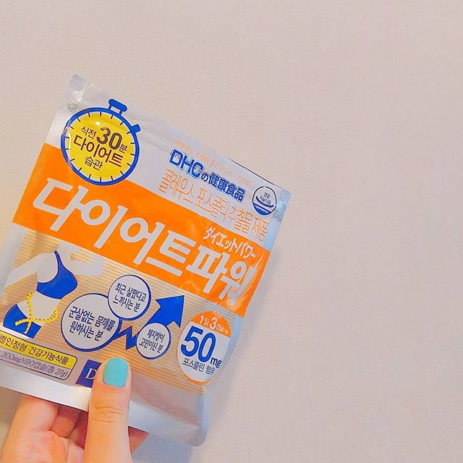

Dominant Colour of Foreground
Foreground colour = Green Likes = 3597 | Foreground colour = Black Likes = 4173 | Foreground colour = Orange Likes = 35 | Foreground colour = White Likes = 9

Slide 24
Pictorial Information Extraction
Microsoft / Google API (Application Programming Interface)
Python library for image characteristics: color, brightness, balance, clarity, contrast
Picture mapping: (e.g. Google photo search)

Slide 25
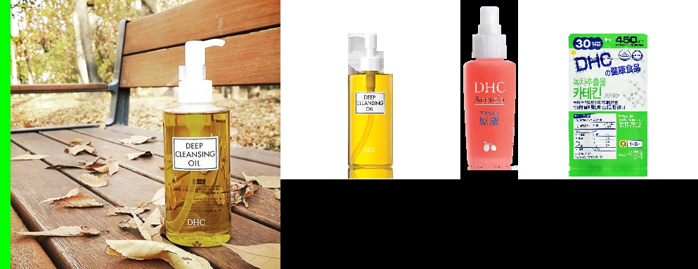
Picture Mapping to detect DHC Korea products
For each Instagram picture, find the most similar product picture.
Check Google Product Search https://cloud.google.com/vision/product-search/docs/
Contributor:
Daniel Han-Chen

Slide 26
Control X variables
These are not main X variables of interest.
But, these are also likely to affect X variables.
If these control variables are not included, the coefficients of interest might be over or under estimated.
Notes:
Eg possible the number of likes
Results might be biased

Slide 27
Control X variables
No of followers & No of following
Network effect
As your friend network is bigger, the chance to be seen is higher and so to receive “like” is higher.
No of posts
Competition effect
As you post more and more, the previous posts quickly go down and so the chance to be seen is lower.

Slide 28
4. Regression:
Data coding & Interpretation for categorial variable
P-value for testing the significance of effect
Analysis: outliers, control X variables

Slide 29
Data coding for “strategy” categorial variables
 | No of columns = 4 - 1 = 3
 | D2 | D3 | D4
Strategy Category | Only Model | Only Product | Model + Product
Neither Model or Product | 0 | 0 | 0
Only Model | 1 | 0 | 0
Only Product | 0 | 1 | 0
Model + Product | 0 | 0 | 1
Baseline

Slide 30
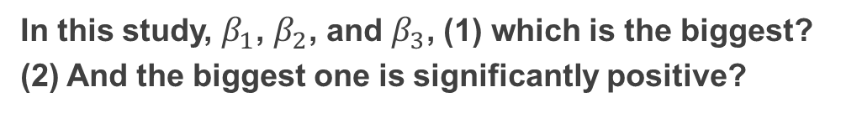
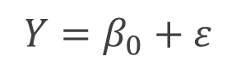
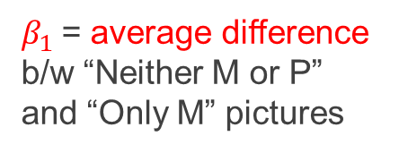
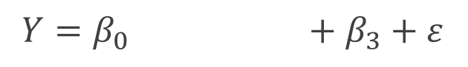
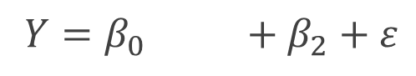
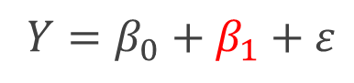
Interpretation for “strategy” categorical variable
$Y=β_{0}+β_{1}onlyM+β_{2}onlyP+β_{3}Both+ε$
Neither Model or Product
Only Model
Only Product
Model + Product
$Y=β_{0}+ε$
$β_{1}$= average difference b/w “Neither M or P” and “Only M” pictures
$Y=β_{0}+β_{1}+ε$
$Y=β_{0} +β_{2}+ε$
$Y=β_{0} +β_{3}+ε$
In this study, $β_{1}$, $β_{2}$, and $β_{3}$, (1) which is the biggest?
(2) And the biggest one is significantly positive?

Slide 31
4. Regression:
Data coding & Interpretation for categorial variable
P-value for testing the significance of effect
Analysis: outliers, control X variables

Slide 32
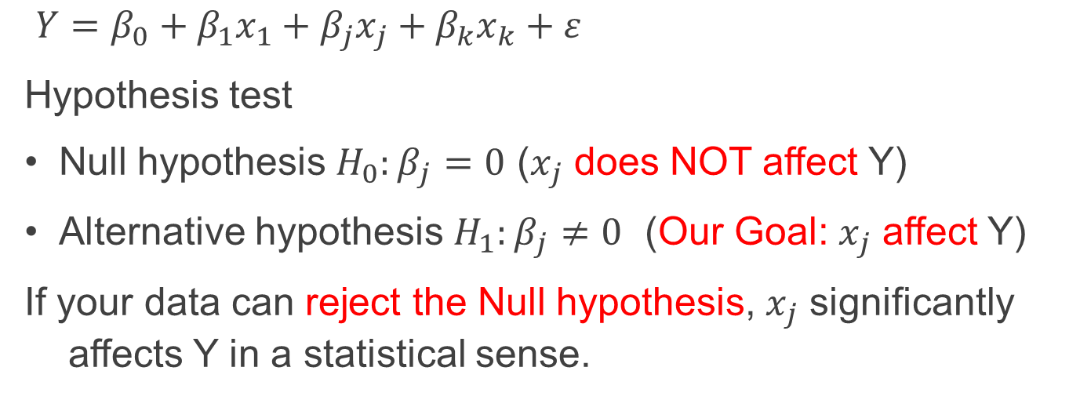
Does $x_{j}$ affect Y significantly?
$Y=β_{0}+β_{1}x_{1}+β_{j}x_{j}+β_{k}x_{k}+ε$
Hypothesis test
Null hypothesis ${H_{0}:β}_{j}=0$ ($x_{j}$ does NOT affect Y)
Alternative hypothesis ${H_{1}:β}_{j}≠0$ (Our Goal: $x_{j}$ affect Y)
If your data can reject the Null hypothesis, $x_{j}$ significantly affects Y in a statistical sense.

Slide 33
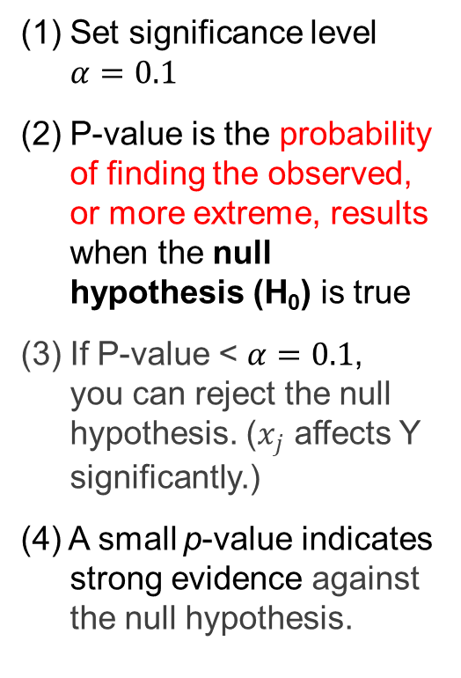
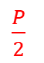
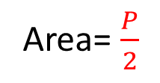
Decision Rule: P-value
(1) Set significance level $α=0.1$
(2) P-value is the probability of finding the observed, or more extreme, results when the null hypothesis (H₀) is true
(3) If P-value < $α=0.1$, you can reject the null hypothesis. ($x_{j}$ affects Y significantly.)
(4) A small p-value indicates strong evidence against the null hypothesis.
$\frac{P}{2}$
Area= $\frac{P}{2}$

Slide 34
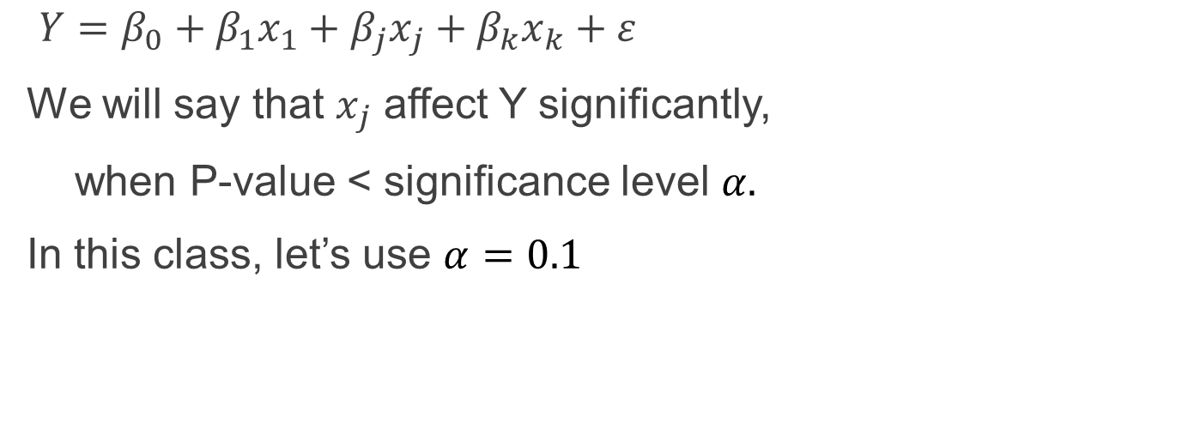
Does $x_{j}$ affect Y significantly?
$Y=β_{0}+β_{1}x_{1}+β_{j}x_{j}+β_{k}x_{k}+ε$
We will say that $x_{j}$ affect Y significantly,
when P-value < significance level $α.$
In this class, let’s use $α=0.1$

Slide 35
4. Regression:
Data coding & Interpretation for categorial variable
P-value for testing the significance of effect
Analysis: outliers, control X variables

Slide 36
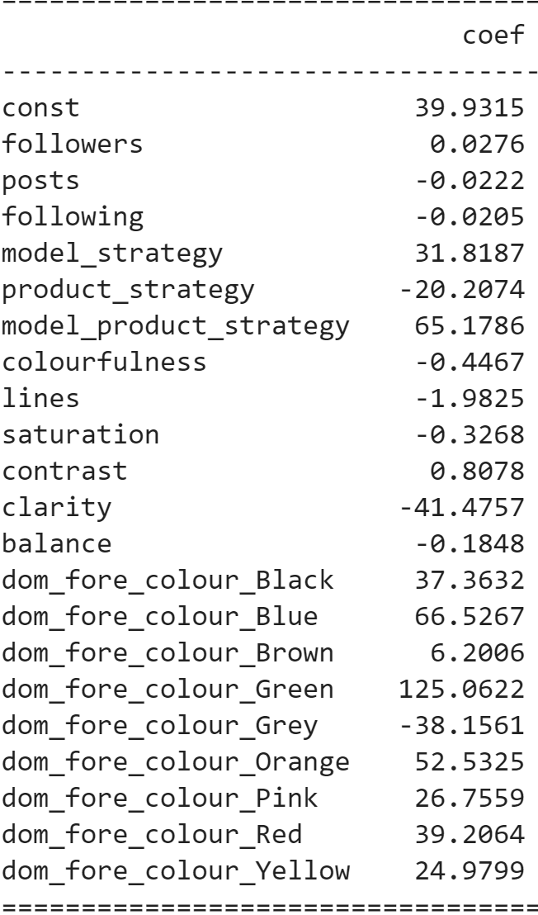
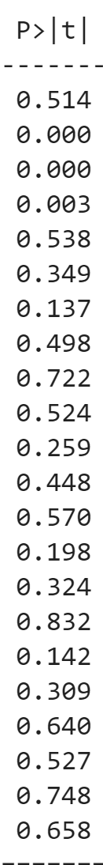
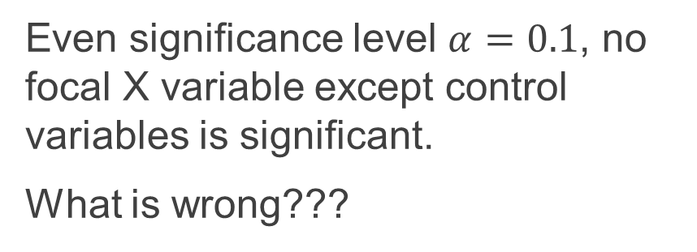
Result using all the data
Even significance level $α=0.1$, no focal X variable except control variables is significant.
What is wrong???

Slide 37
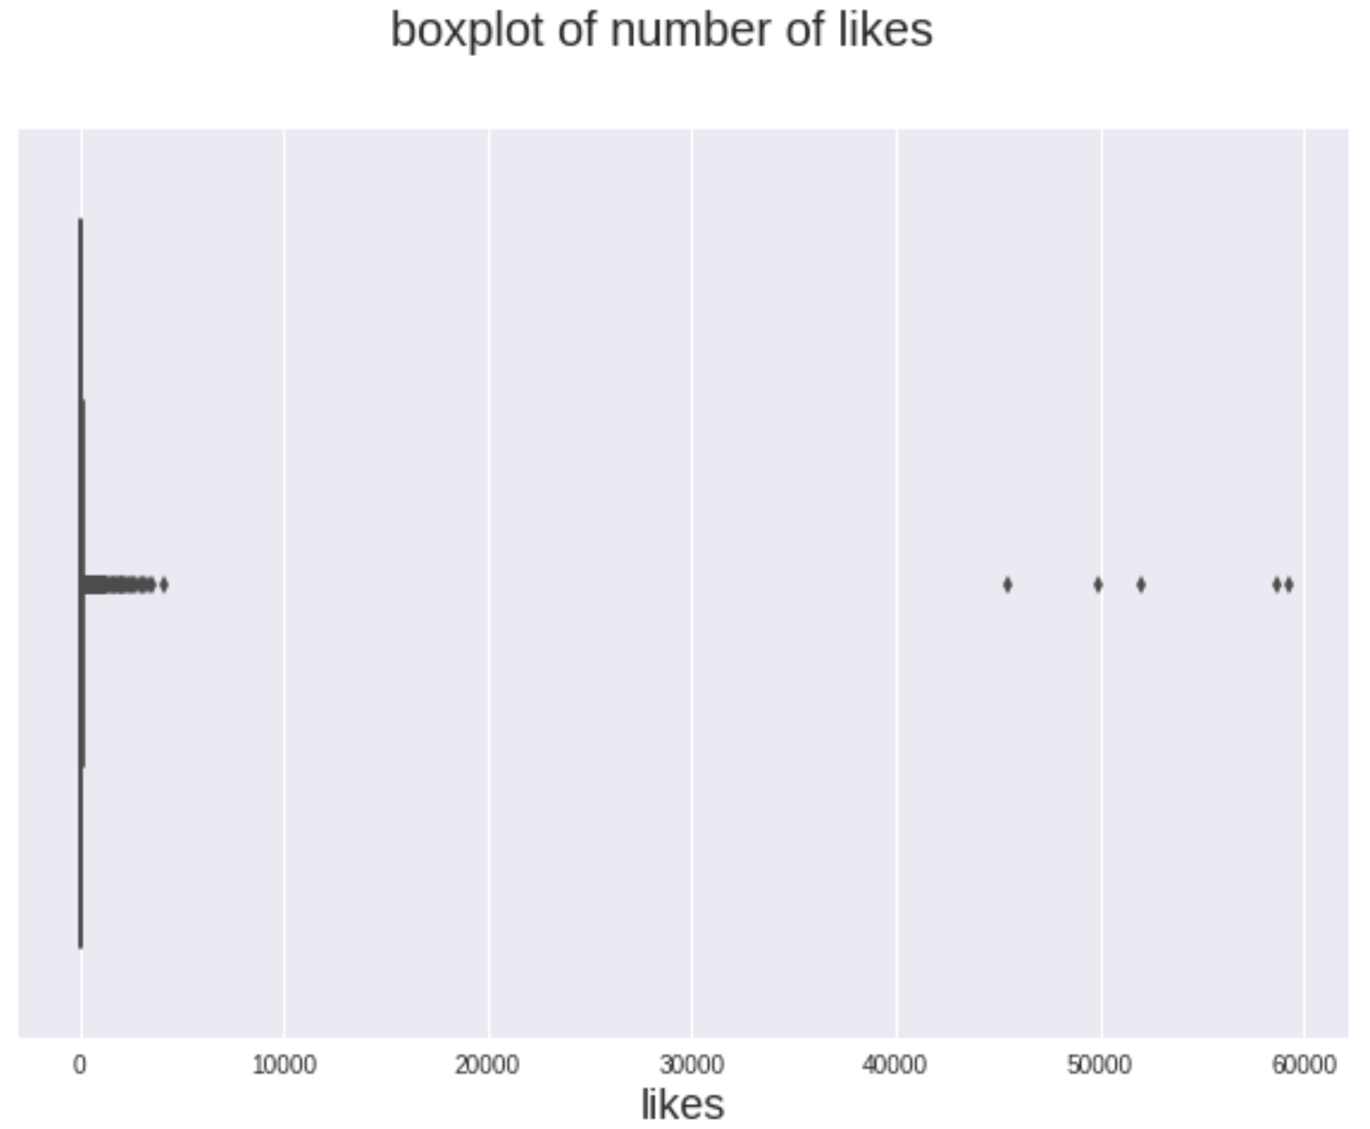
Investigating outliers in Y (No of like)
A few picture received lots of “like”.
This may be due to unobserved “event”. For example, sometimes, company do new product launching event by spending lots of advertising cost. We don’t have X variables to capture such events.
Then, one might exclude these “outliers”.

Slide 38
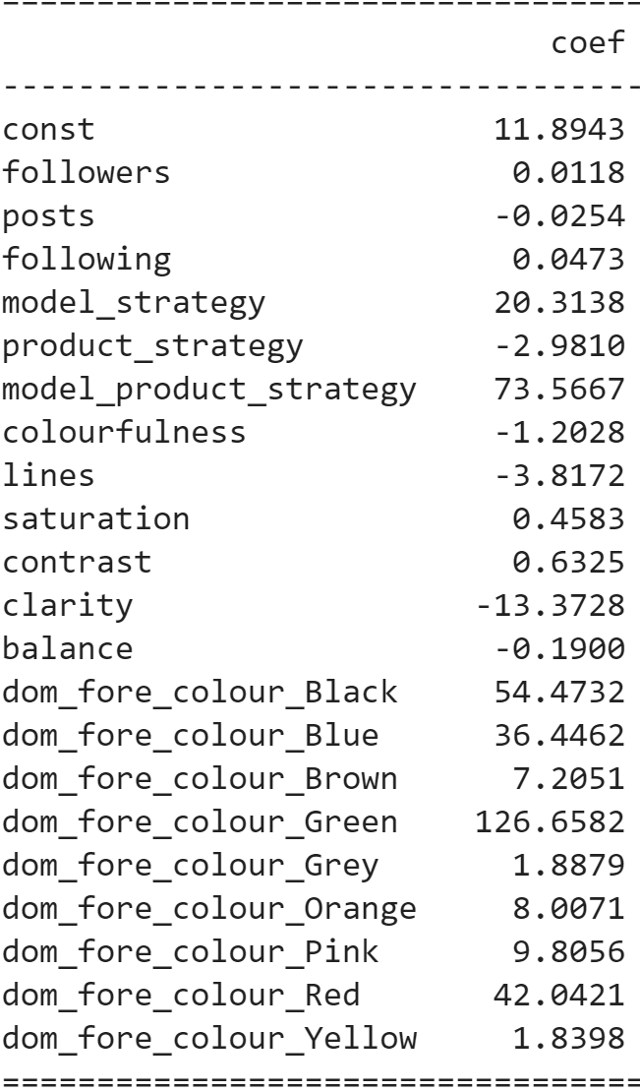
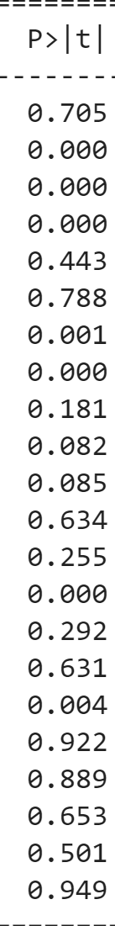
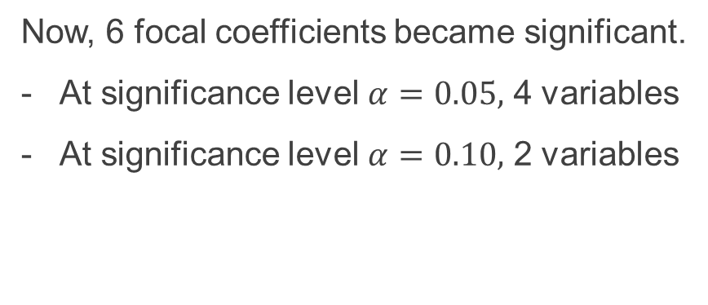
Result after excluding outliers
Now, 6 focal coefficients became significant.
At significance level $α=0.05,$ 4 variables
At significance level $α=0.10,$ 2 variables

Slide 39


“Model + Product” strategy is significantly the best.
“Only Model” and “Only Product” are not significantly different from baseline pictures.
Neither
(Baseline)
Only
Model
Only
Product
Model +
Product

Slide 40
Fore Colour: Green > Black > other colors
Red and Blue are NOT significantly different from baseline colour white.
Why? I will come back the next week.
(Baseline)
Notes:
- Eye sensitive to green??? Lol show off guy said this wattt

Slide 41
High Saturation & High Contrast are good
<
Saturation = 4.26 (low) Likes = 60 | Saturation = 201.7 (high) Likes = 2056
Contrast = 13.81 (low) Likes = 3 | Contrast = 94.5 (high) Likes = 889
<

Slide 42
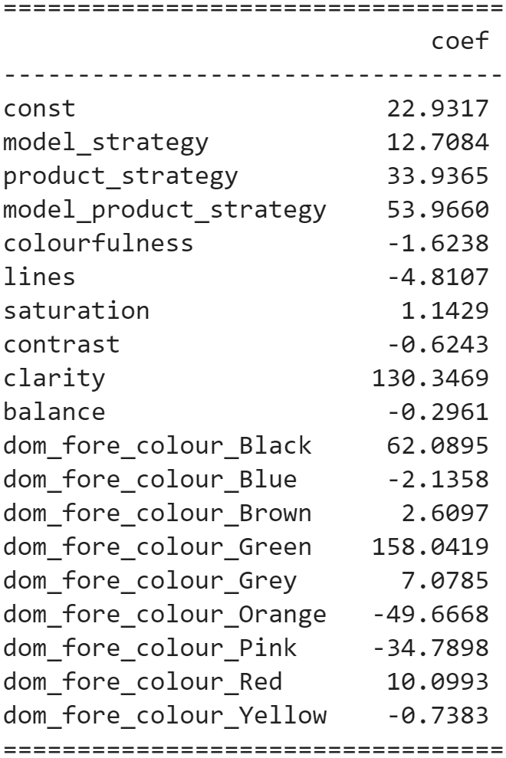
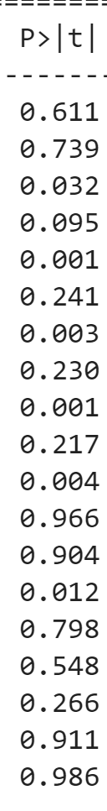
What if not including control X variables?
With Control
Without Control
Effect size changes dramatically.
“Only Product strategy” and “Clarity” also became significant.
It might mislead decision-making.

Slide 43
Conclusion
Pictorial information extraction became possible. Thank you AI~
Facial feature (celebrity, emotion, gender, age, ethnicity…) / object detection
Picture characteristics
Picture mapping (picture search)
Regression
For categorical X variables, interpret the effect relatively compared to baseline category.
Check outliers
Add necessary control variables (Know business context).
Exciting time to analyse Picture Advertising. In general, any picture!

